Slide 1
Equity in Higher Education: A National Imperative Search for Solutions Dialogues
National Press Club February 3, 2015
Margaret Cahalan, Pell Institute for Study of Opportunity in Higher Education, Council for Opportunity in Education (COE)
Laura Perna, Alliance for Higher Education and Democracy (AHEAD)
University of Pennsylvania

Slide 2
Past, current and future
Pell Institute and PennAHEAD staff and associates
Government and contractor teams who collected the data and produced the comparable estimates

Slide 3
Schedule for the Morning
Welcome (10 minutes)
Overview of Indicators (20 minutes)
Table discussion of dialogue questions (20 minutes)
Table Report-out (20 minutes)
Closing/Next Steps (5 minutes)

Slide 4
Purpose of Report and Dialogues
Report on progress and provide tool for monitoring progress
Identify policy and practices needed to improve equity
Engage multiple stakeholders in shared dialogue

Slide 5
The Equity Indicators
Who enrolls in postsecondary?
What types of institutions do students attend?
Does financial aid eliminate the financial barriers?
How do students pay for college?
How does bachelor’s degree attainment vary by family income?
How do attainment rates in U.S. compare to other countries?

Slide 6
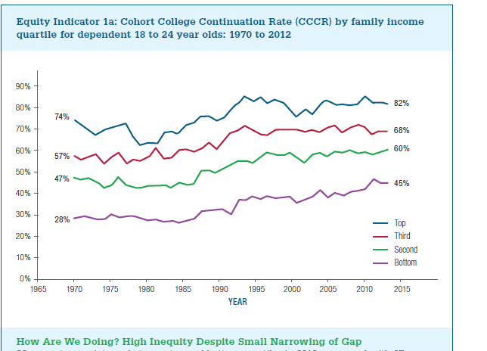

Slide 7
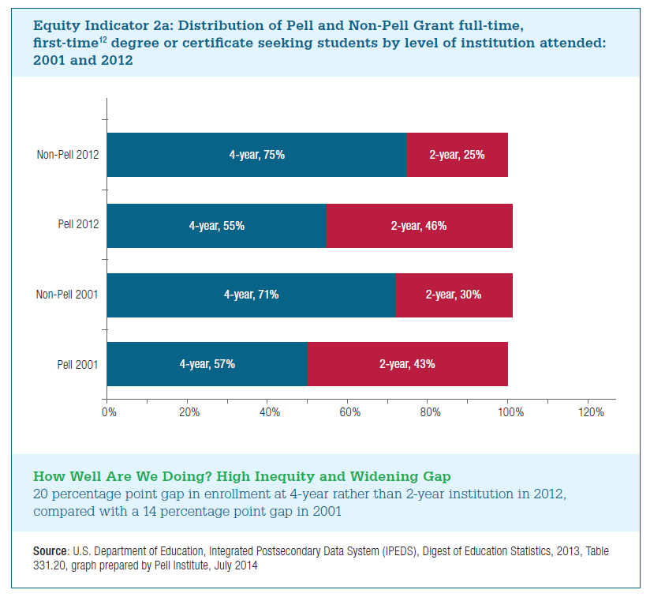

Slide 8
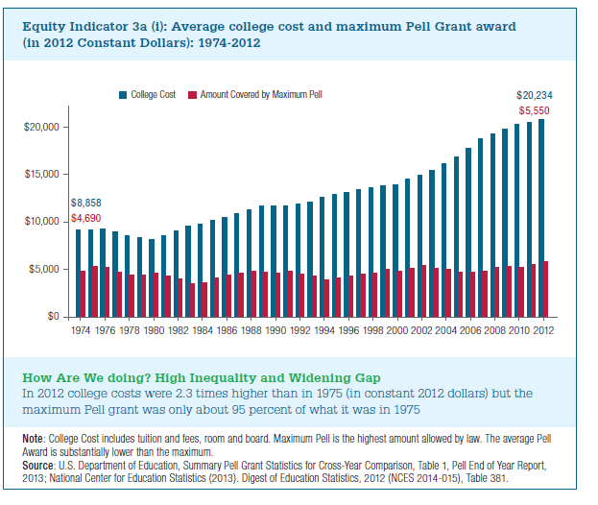

Slide 9
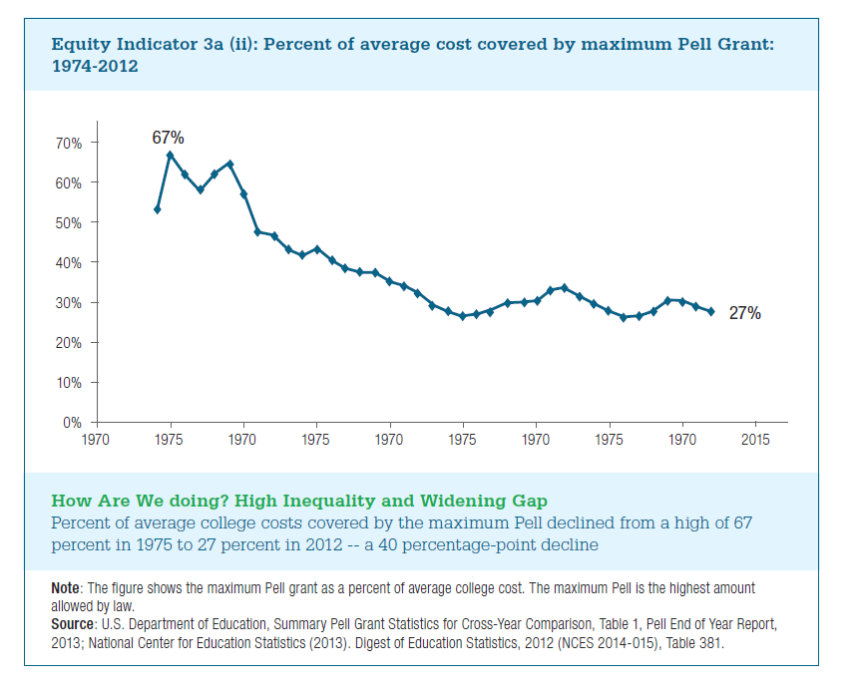

Slide 10
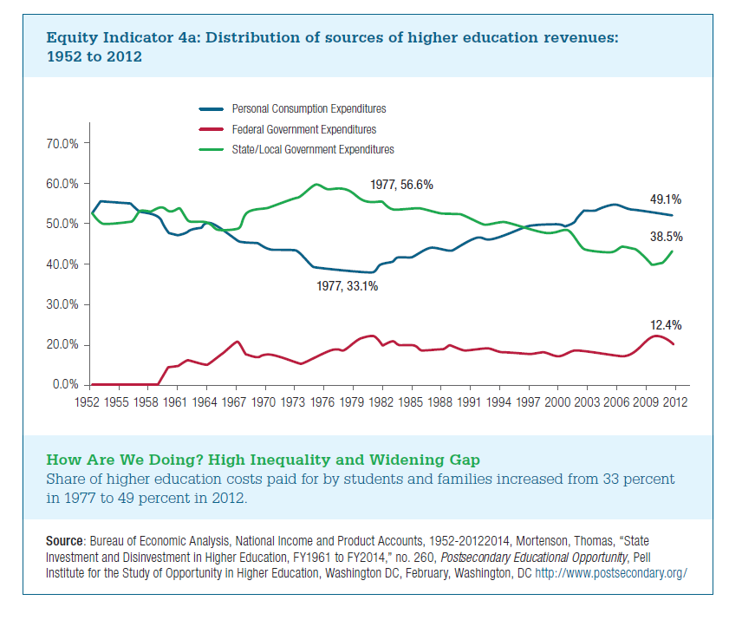

Slide 11
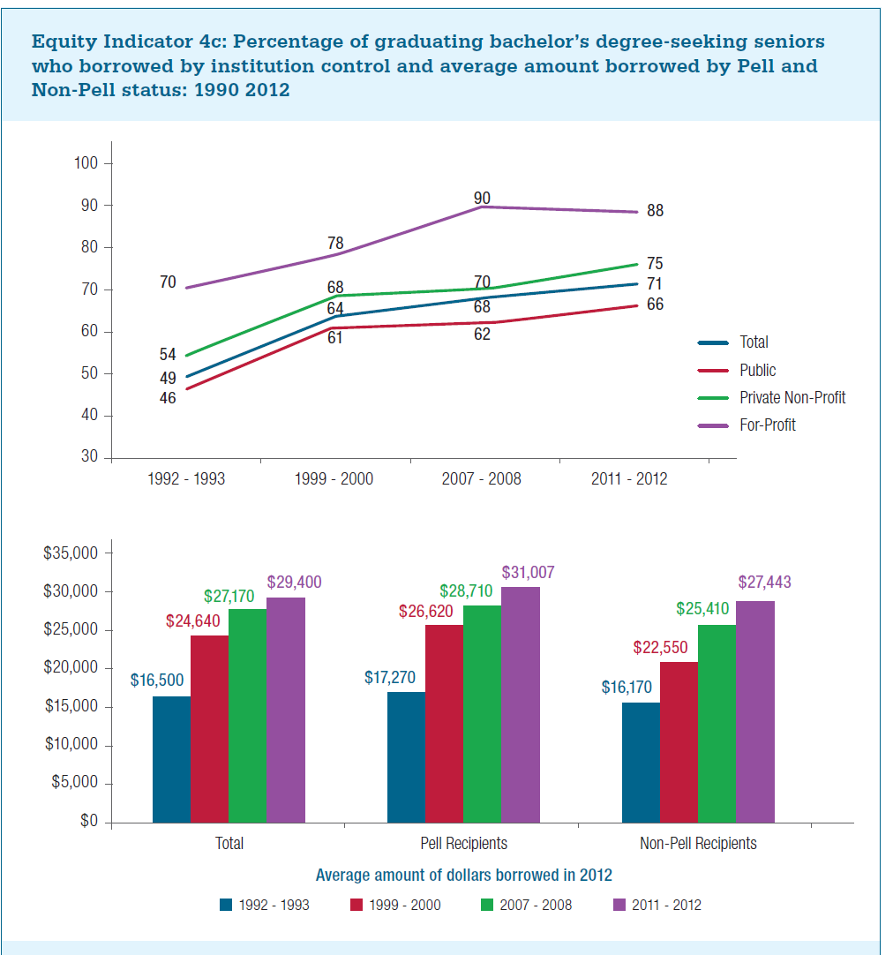

Slide 12
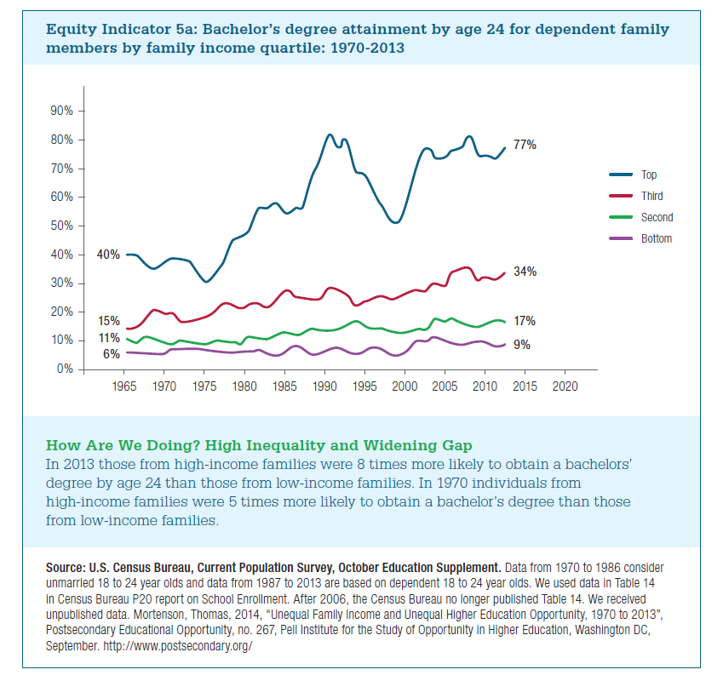

Slide 13
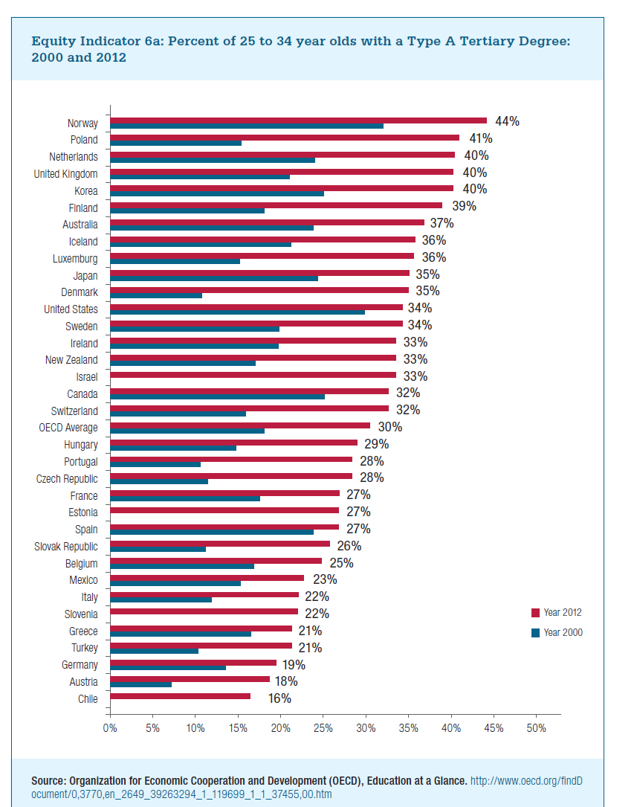

Slide 14
Improving Equity in Higher Education Attainment: A National Imperative—Laura’s Reflection
Improving equity requires policies that improve:
College affordability
Academic readiness for college-level work
Knowledge of college and financial aid
Transfer across higher education institutions
Improving equity is a responsibility shared by:
Federal government
State governments
Colleges and universities

Slide 15
16 Strategies for Widening Participation—Maggie’s Reflection
Incentivize completion –loans to grants if complete
Address SAP issues through prevention and rewarding improvement
Integration of work and learning
Increased support for full-time attendance and reduced work loads for students
Inclusivity valued over selectivity rewarding institutions for serving less prepared students
Holistic approach to support throughout life cycle of individual
Institutional equalization and increased valuing of diversity of assets
Recognizing the need for reform of evaluation research to be more valid and responsive and respectful of expert knowledge of practitioners
Setting place based achievable targets and means to attain
Increasing reach of proven high school college access programs
Focus on retention and increased support services in institutions
Competency based learning and prior learning recognition (PLR)
Focus on transition point support
Restoring public funding levels
Universal free first two years
Place based scholarship for students private and public supported—Kalamazoo, Denver

Slide 16
Table Dialogue Questions
What do you personally think are the top 3 changes needed to improve equity in higher education in the U.S.?
What is required to implement the changes?
How can we encourage more attention among the higher education research and policy community to questions of poverty, equity, and mobility?
What should the next generation of equity research and evaluation look like? Lessons learned from past attempts?
What are the possibilities for practitioners, government, and academics to partner in achieving needed changes?

Slide 17
Closing
Next steps:
Continuing the shared dialogue
Reflections on today’s discussion
Posting of the compiled results
Continuing to track trends in higher education equity
Second edition of this annual publication
Focus of subsequent editions

