Slide 1


Near-Peer College Advising: A Successful Strategy for Increasing Financial Aid Awards In Underserved High Schools
Missouri College Advising Corps
Chelsea Sims
Cherelle Washington
Beth Tankersley-Bankhead
27th Annual
Student Financial Aid Research Network Conference
June 2, 2011

Slide 2
National and Missouri College Advising Corps Model: A Unique College Access Program
Near-peer model
Full-time college advisers
Immersed in the partner school
100% focus on college planning
Headquartered at postsecondary institutions
Intensive pre-service and in-service training

Slide 3
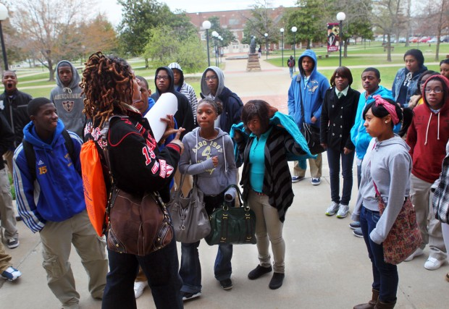
Students Served in Missouri
9th – 12th graders
>78% first-generation
to college
89% in urban and 69%
in 11 total partner
high schools underrepresented
>73% free and reduced lunch-eligible

Slide 4
College Advisement Services
One-on-one advising
Workshop/group advisement
College application assistance
Campus tours
ACT prep and registration
FAFSA completion assistance
Financial aid and financial literacy information
Scholarship search and application assistance
Advisement to families/parents

Slide 5
Research Framework
Curs, B., & Singell, L. D. Jr., (2002). An analysis of the application and enrollment processes for in-state and out-of-state students at a large public university.
Dynarski, S. M. (1999). Does aid matter? Measuring the effect of student aid on college attendance and completion.
Heller, D. E. (1997). Student price response in higher education: An update to Leslie and Brinkman.
Panera, L. W. (2006). Understanding the relationship between information about college prices and financial aid and college-related behaviors.
Savoca, E. (1990). Another look at the demand for higher education: Measuring the price sensitivity of the decision to apply to college.
Education Trust (June 1, 2011). For low-income students, turning college dreams into reality isn’t easy

Slide 6
Research Foundation
For high-need, low-income students –
like those served by MCAC – filing the Free
Application for Federal Student Aid
(FAFSA) may be the most critical step
to complete and the best predictor of
whether students will apply for college.
Bowen, W., Chingos, M., and McPherson. M., 2009, Crossing the finish line: Completing college at America’s public universities, Princeton University Press.

Slide 7
Questions
Given that 40% of MO students eligible for state and
federal aid do not submit the FAFSA by the State
deadline and given that MCAC serves in schools with
>70% low-income students:
How can MCAC college advisers boost the number of students submitting FAFSAs by the State deadline?
How can MCAC college advisers assist students in securing scholarships and institutional aid?

Slide 8
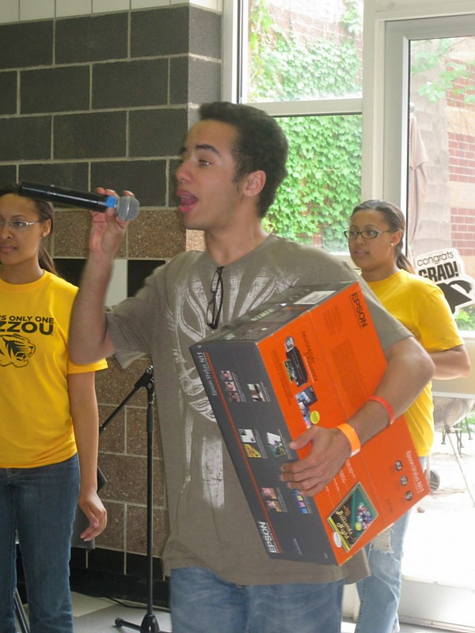
Strategies Implemented
8-week FAFSA Work Plan
Consult with school staff
Weekly benchmarks
Strategies to reach goals
Daily announcements and visits
to senior advisement classes

Slide 9
Strategies Implemented
Financial Aid Night
In December
Presentation on types of aid (grants, scholarships, loans)
Assisted parents and students with applying for FAFSA pin
PINS in the Cafeteria
Seniors applied for FAFSA PINS during lunch

Slide 10
Strategies Implemented
FAFSA Nights
After school completion every Monday &
Wednesday, January – March 31, 2011
Postcard home to families
March Madness
Raffle every Friday in March for students that successfully completed/submitted the FAFSA
Incentives: microwave, DVD Player, iPod, printer

Slide 11
Strategies Implemented
Weekly Reminders
Automated Calls
Financial Aid Workshop
FAFSA Frenzy
FAFSA Nights

Slide 12
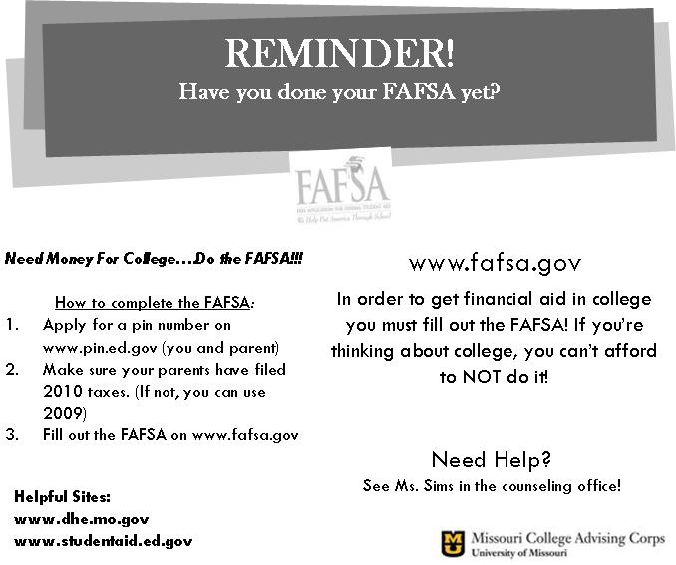
Strategies Implemented

Slide 13
Strategies Implemented
Financial Aid Workshop
Facilitated by financial aid officer from local postsecondary institution
Highlighted types of aid (grants, loans, scholarships) and how to apply for each
Followed immediately by FAFSA Frenzy

Slide 14

Strategies Implemented
FAFSA Frenzy
Sponsored by Missouri Department of Higher Education
Provided promotional materials and training to site coordinators
Open to the community
Volunteers: MCAC college advisers, teachers, and financial aid professionals from postsecondary institutions

Slide 15
Results – as of April 2011
133 financial aid/literacy workshops
2,246 students assisted with scholarship applications
$3.5M in private and institutional aid
2,216 students assisted with FAFSA
  1,283 assisted last year with same # advisers
  Cherelle and Chelsea – 341 of 377 seniors assisted

Slide 16
Results
Students applied to over 350 institutions
Students admitted to 250+ institutions
6.4% increase in college-going – year 2
4.6% increase in college-going – year 1

Slide 17
Q & A and Dialogue
Contact Information:
Missouri College Advising Corps
46 Jesse Hall
University of Missouri (MU)
Columbia, MO 65211
573-884-12928
tankersleybankheaea@missouri.edu
http://mcac.missouri.edu/

