Slide 1
Use of Student Transcript Data to Inform Financial Aid Analysis at the National Level

Slide 2
Postsecondary Education Transcript Study
Jennifer Wine
RTI International

Slide 3
Agenda
Introduction
Overview of the Postsecondary Education Transcript Study
Transcript data collection
Possible uses for financial aid analysis:
  Time to degree example
  Cumulative federal loans and Pell grants example
Conclusion

Slide 4
National Postsecondary Student Aid Study (NPSAS)
Periodic cross-sectional study of students enrolled in postsecondary education, at all levels, in a specific financial aid year
Sponsored by the National Center for Education Statistics (NCES) in the Institute of Education Sciences, U S Department of Education
Authorized by the Higher Education Opportunity Act of 2008, 20 U.S.C. § 1015(d) which charges NCES with collecting information from aid recipients in the United States
Serves as the base year study for two longitudinal cohort studies, the Beginning Postsecondary Students (BPS) and the Baccalaureate and Beyond (B&B) longitudinal studies

Slide 5
Main Purpose of NPSAS
To understand how students and their families finance postsecondary education, NPSAS provides data on:
  Current costs of postsecondary education
  Resources used by students to meet those costs, including financial aid, employment, and family support
  The student, including their enrollment status and history, education experiences, and background
  Issues specific to the longitudinal cohort studies, such as goals, education and career plans, and decision making

Slide 6
Beginning Postsecondary Students Longitudinal Study (BPS)¹
Follows a cohort of first time college students who, in their first year of postsecondary education, were enrolled in an academic program, in at least one course for credit, or in a vocational program requiring 3+ months or 300 clock hours of instruction
Data collections occur in their first, third, and sixth academic years following admission
BPS:2004 cohort:
  About 18,600 traditional and nontraditional age students who first enrolled at Title IV-eligible postsecondary institutions during the 2003-04 academic year
  Data collection occurred in 2004, 2006, and 2009
¹http://nces.ed.gov/surveys/bps/

Slide 7

Main Purpose of BPS
Understand topics related to:
  Persistence, transfer, and degree attainment in postsecondary education
  Costs and financing of postsecondary education
  Employment and job change
  Finances and debt
  Career and personal goals, family status, civic participation

Slide 8
Baccalaureate and Beyond Longitudinal Study (B&B:08)¹
Follows a cohort of new baccalaureate degree recipients attending Title IV-eligible institutions.
Data collections occur in their last year of college and their first and fourth years after completing degree requirements.
B&B:08 cohort:
  About 18,500 students who completed requirements for the bachelor’s degree at Title IV-eligible postsecondary institutions during the 2007-08 academic year
  Students were interviewed in 2008 and 2009, and will be interviewed again in 2012
¹http://nces.ed.gov/surveys/b&b/

Slide 9

Purpose of B&B
Understand topics related to graduates’:
  Postsecondary education up to degree award
  Post-baccalaureate education and education plans
  Employment, career plans and decision making
  Family status, civic participation, and other life experiences since leaving college
¹http://nces.ed.gov/surveys/b&b/
Notes:
Will comment that, at this point, we’ll leave B&B to focus specifically on the BPS transcript collection and data.

Slide 10
Sources of Data for NPSAS, BPS:04, and B&B:08
Student record abstraction during first year (BPS) or last year (B&B) of enrollment at the base-year institution only
Student interviews
Administrative record matching
  Central Processing System
  National Student Loan Data System
  ACT, SAT
  National Student Clearinghouse
Transcripts
  BPS:04: Transcripts were requested from all institutions attended since the first year
  B&B:08: Transcripts were requested only from institutions awarding the bachelor’s degree

Slide 11
Postsecondary Education Transcript Study (PETS:09)
Transcript collection for BPS:04 and B&B:08 combined as the Postsecondary Education Transcript Study (PETS:09) to maximize efficiency and minimize burden on participating institutions
BPS:04:
  Collected transcripts from about 87 percent of institutions for about 87 percent of students
B&B:08:
  Collected transcripts from about 93 percent of institutions for about 94 percent of students

Slide 12
Transcript Data Collection
Michael Bryan
RTI International

Slide 13
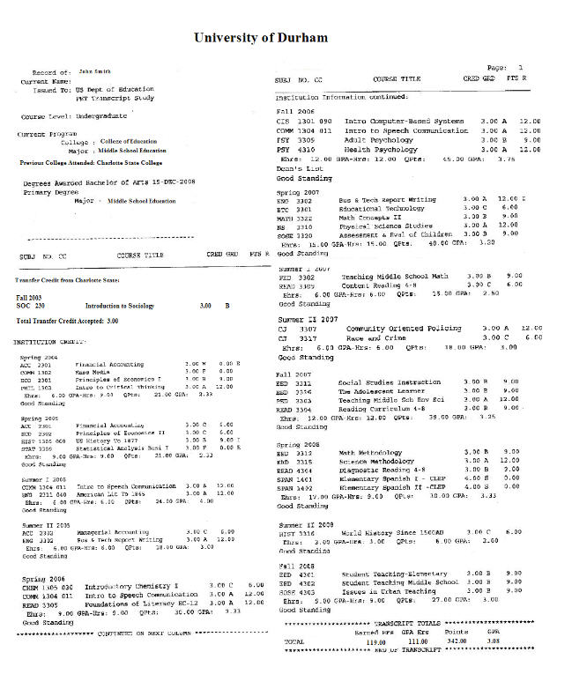

Slide 14
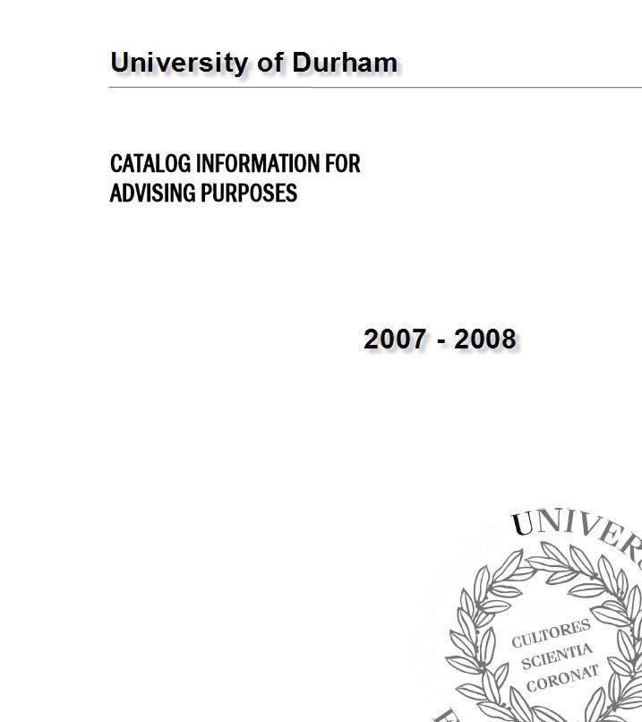

Slide 15
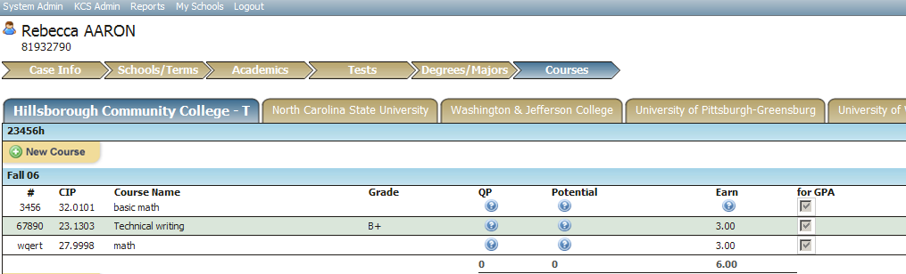
Transcript Data Collection

Slide 16
Transcript Data Collection
Organized by common types of transcript data
  Case Info
  Schools/Terms
  Academics
Data coded using familiar systems
  Classification of Instructional Programs (CIP)
    Majors
    Courses (modified CIP)
  Integrated Postsecondary Education Data System (IPEDS)
  Tests
  Degrees/Majors
  Courses

Slide 17
Derived Variables—Continued
Concept: Elapsed time to bachelor’s degree
Date of bachelor’s degree
-
Date of first postsecondary enrollment
=
Elapsed time to bachelor’s degree
¹ http://www.collegesource.org/

Slide 18
PETS topic areas
Section | Number of “direct pull” variables | Number of derived variables | Total
Total | 140 | 472 | 612
Institutional characteristics | 29 | 21 | 50
Coursework | 55 | 302 | 357
Pre-college information | 1 | 13 | 14
Degree and awards information | 28 | 48 | 76
Enrollment and attendance | 24 | 54 | 78
Transfer history | 3 | 34 | 37

Slide 19
Example variables
Time and credits to degree | Income and dependency status
Remedial or developmental courses | Tuition and Fees, by institution type
Transfer percentages | Attendance intensity
Transfer institution relationships (e.g. selectivity, level) | Received federal aid, grants, loans, other
Credits and GPA in course subject clusters | Institution characteristics (e.g. level, control)
Program of study (e.g. BA, AA, certificate) | Hours worked
AP and other non-course credits earned | Student characteristics (e.g. race, ethnicity)
Number of terms enrolled | Dependency status

Slide 20
Possible Uses of Transcript data for Financial Aid Analysis
Sean Simone
National Center for Education Statistics

Slide 21
Time to Degree Example

Slide 22
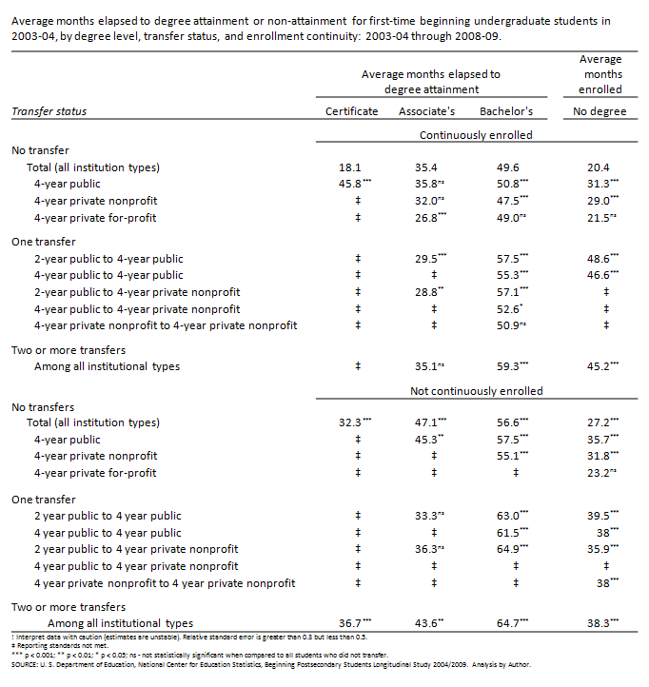

Slide 23
Average months elapsed to degree attainment or non-attainment for first-time beginning undergraduate students in 2003-04, by degree level, transfer status, and enrollment continuity: 2003-04 through 2008-09.

Slide 24
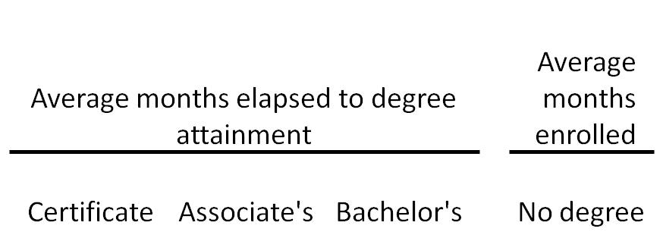

Slide 25
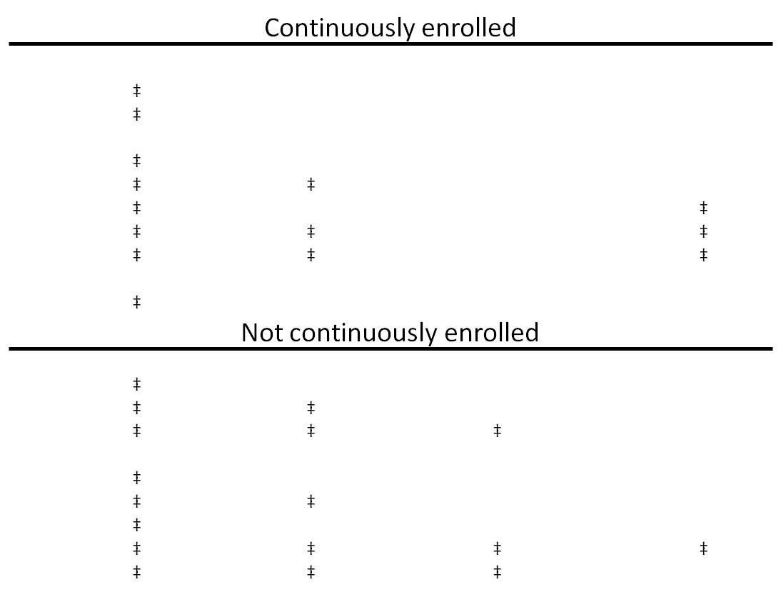

Slide 27
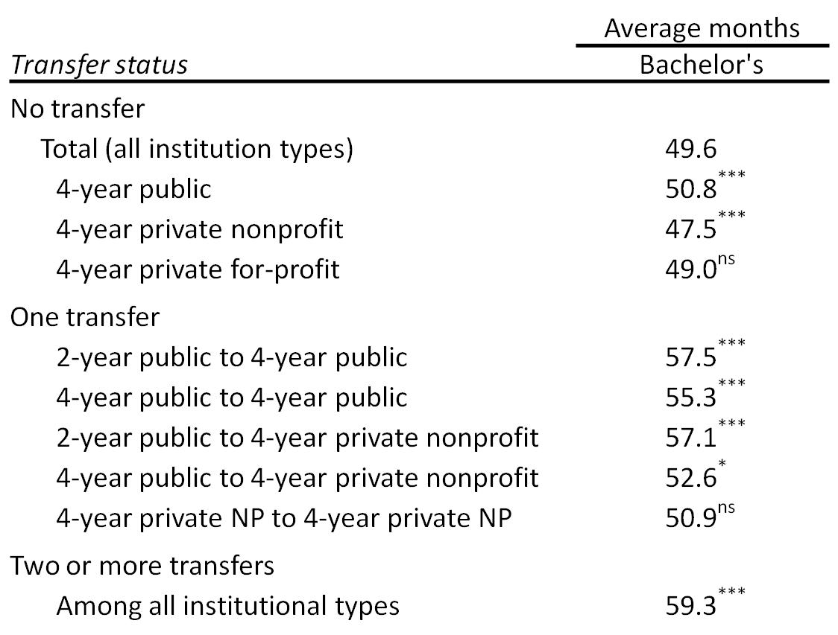

Slide 28
Cumulative Loans &
Pell Grants Example

Slide 29
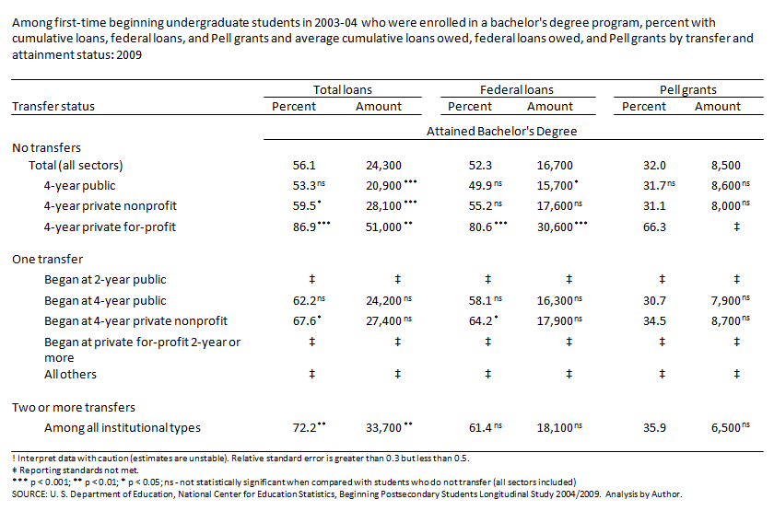

Slide 30
Among first-time beginning undergraduate students in 2003-04 who were enrolled in a bachelor's degree program, percent with cumulative loans, federal loans, and Pell grants and average cumulative loans owed, federal loans owed, and Pell grants by transfer and attainment status: 2009

Slide 31
Attained Bachelor’s Degree

Slide 33
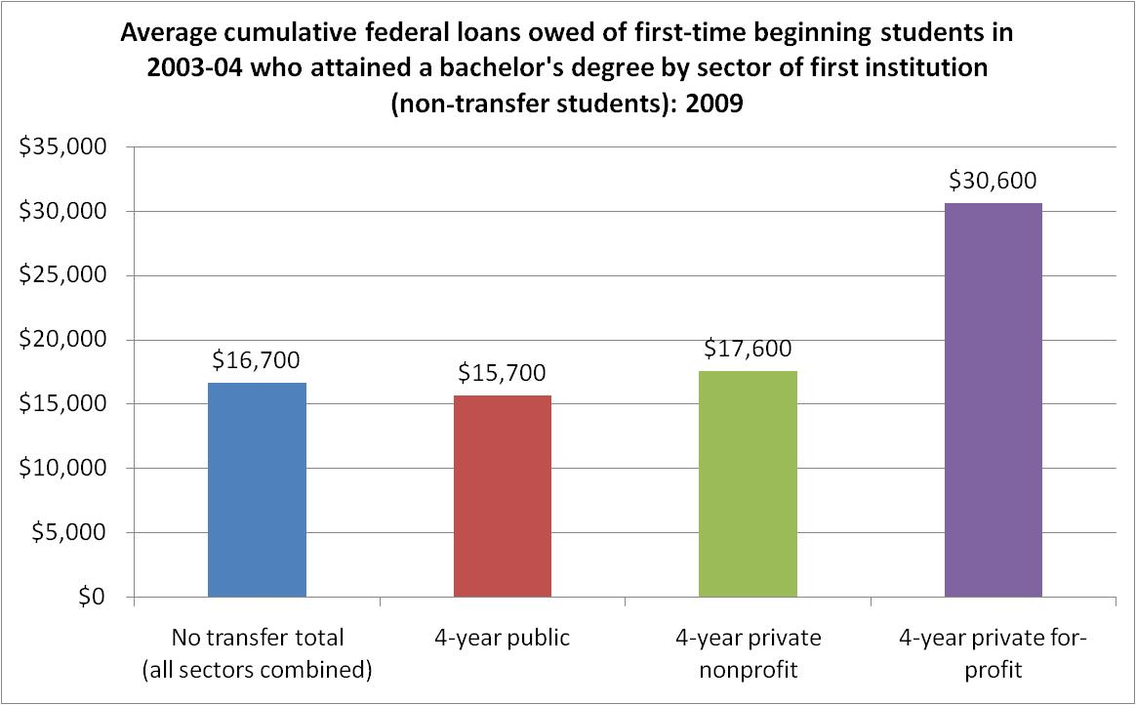

Slide 34
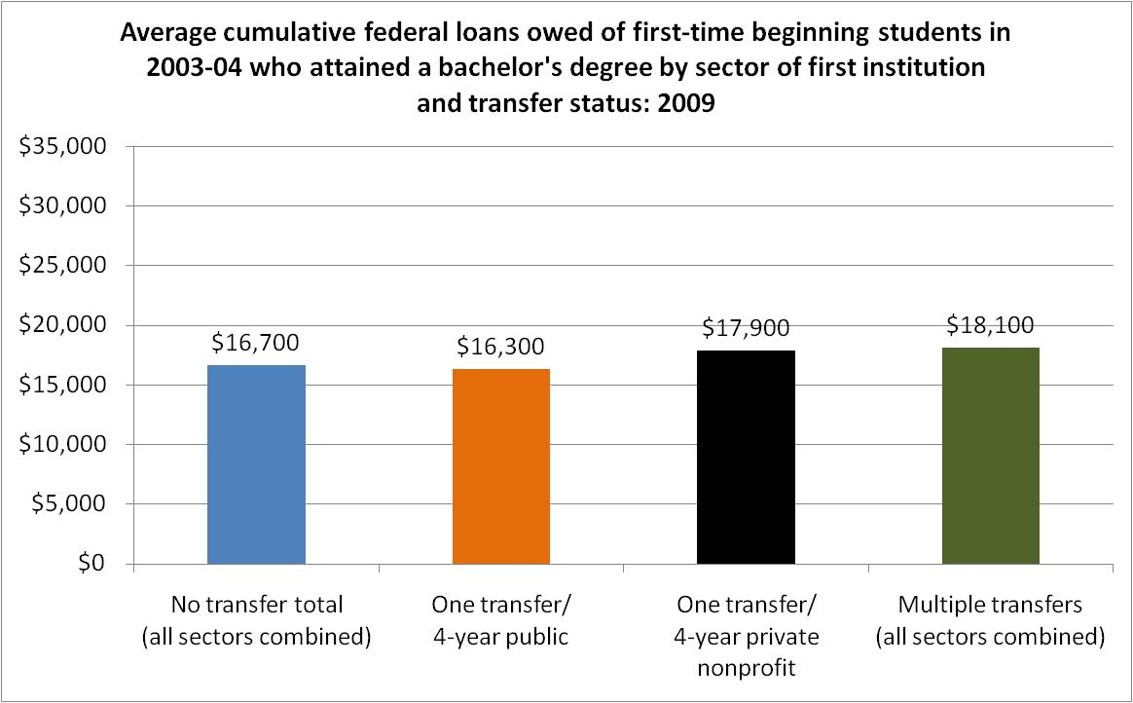

Slide 36
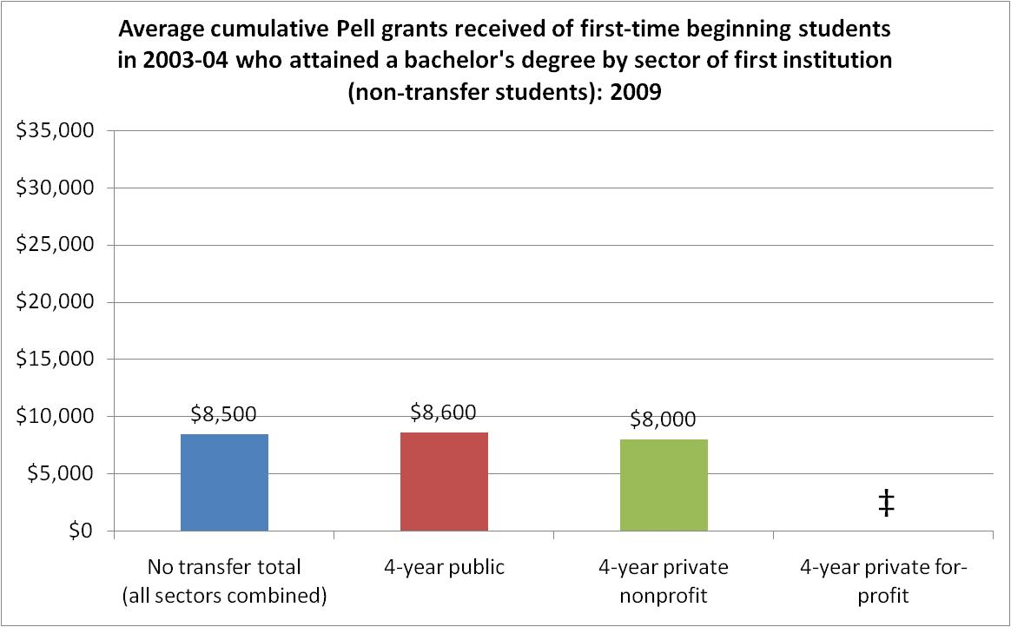

Slide 37
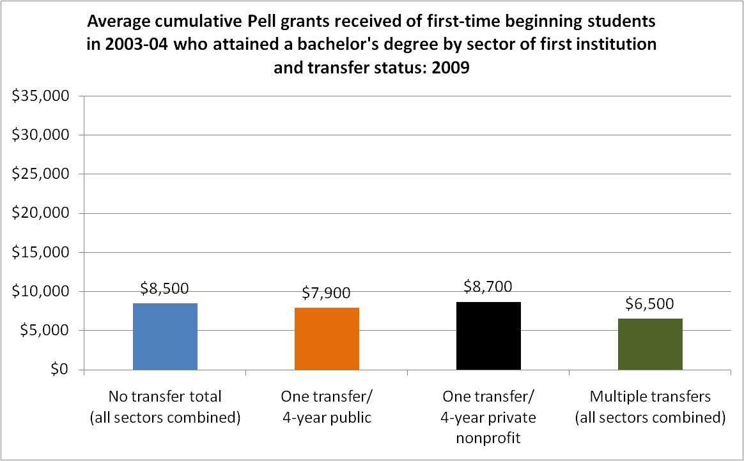

Slide 38
Data Products

Slide 39
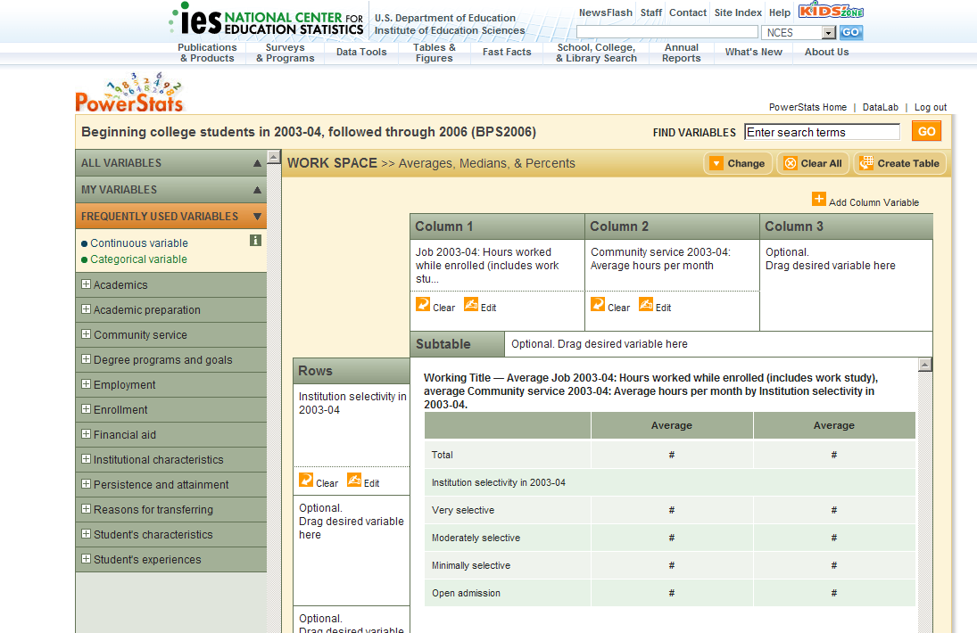
Availability: PowerStats (nces.ed.gov/datalab)
Notes:
PowerStats
Public-access
Student-level
Web-based
Focus is on ease-of-use and accessibility
Can be used to produce table and conduct common multivariate analyses (e.g., regression, logistic regression, correlation)
Electronic Codebook (ECB)
Restricted-use
Data at multiple levels (e.g., institute, terms, transcript)
Requires stand alone statistics/data manipulation program
Focus is on comprehensiveness and analytical flexibility
Both scheduled to be available Fall 2011

Slide 40
Availability: Restricted Use Datafile
Electronic Codebook (ECB)
  Restricted-use
  Data at multiple levels (e.g., institute, terms, transcript)
  B&B:08/09 license holders should have access to transcript data on the same ECB
  BPS:04/09 license holders will need to apply for a separate license
Notes:
PowerStats
Public-access
Student-level
Web-based
Focus is on ease-of-use and accessibility
Can be used to produce table and conduct common multivariate analyses (e.g., regression, logistic regression, correlation)
Electronic Codebook (ECB)
Restricted-use
Data at multiple levels (e.g., institute, terms, transcript)
Requires stand alone statistics/data manipulation program
Focus is on comprehensiveness and analytical flexibility
Both scheduled to be available Fall 2011

