Slide 1
Gaining Options for College Collaborative
Testing New Models for Talent Search: Using Data, Empowerment Evaluation and Systems Collaboration
Dr. Nicole Norfles
Dr. Margaret Cahalan
Dr. Stephanie R. Miller
Council for Opportunity for Education

Slide 2
Topics
Overview of the pilot project and Go-College (i3)project (Stephanie)
Project components
    Using data (Stephanie)
    Collaboration (Nicole)
    Traditional and empowerment evaluation (Maggie)
Discussion and Questions (all)

Slide 3
Pilot Project (GE Project)
Project support by the GE Foundation
Launched in 2006
Student-level intervention (60 students)
Located in four sites
  Louisville, KY (1 school, n ~= 300 students)
  Erie, PA (3 schools, n ~= 720 students)
  Connecticut (1 school, n ~= 240 students)
  Harlem, NY
    1 school, n ~= 350 students
    1 school (whole school approach), n ~= 800 students

Slide 4
GE Pilot: Project Components
Existing College Access Program (CAPs) serving students in school
Academic and College Coaching Services
  Academic advising (quarterly sessions)
  Weekly/bi-monthly group sessions
  Limited tutoring services
  College exploration
  Summer programming
  One embedded college coach (serving 60 - 80 students per grade)
  Limited whole school effort
Base data driven decision-making
Learning communities

Slide 5
GE Pilot: Preliminary Findings from 1st Graduating Cohort in Louisville
69 students served
  32 students enrolling at 2-year school
  30 enrolling at 4-year school
  3 joining the military
  4 not graduating or transferred
Financial Aid
  18 students received some form of scholarship
  6 students received full scholarships
Majors
  Animal science
  Biology, chemistry
  Math education
  Nursing
  Graphic design
  Pre-pharmacy
  Business

Slide 6
GO College: Investing in Innovation
COE 1 of 49 selected from 1,700 applicants
$20 million grant from Dept. of Education, $4 million match from the GE Foundation
Builds on Talent Search model and GE pilots
Whole school model with intensive learning communities
Implemented in 2 cities: Erie, PA and Louisville, KY
Rigorous external evaluation required (Educational Testing Service - ETS)

Slide 7
GO College: Project Components, Add on Model
base Talent Search vs. GE Pilot vs. GO College
Selection of students/learning communities (intensive services)
Services
Outcomes
Using data/data process (system)
Collaboration
Evaluation (internal and external)

Slide 8
GO College: Collaboration
GO College provides one model where TRIO pre-college programs can meet the rigorous curricula and collaboration requirements of the Higher Education Opportunity Amendments of 2008
The project could be replicated locally by collaboratives of TRIO programs and high school districts.

Slide 9
GO College: Multiple Communities of Learning Stakeholders and Collaborators
Students
COE, Pell
External evaluators
College Access Providers
School & District staff
Funders (ED OII-OPE, GE)
Parents & community

Slide 10


Slide 11
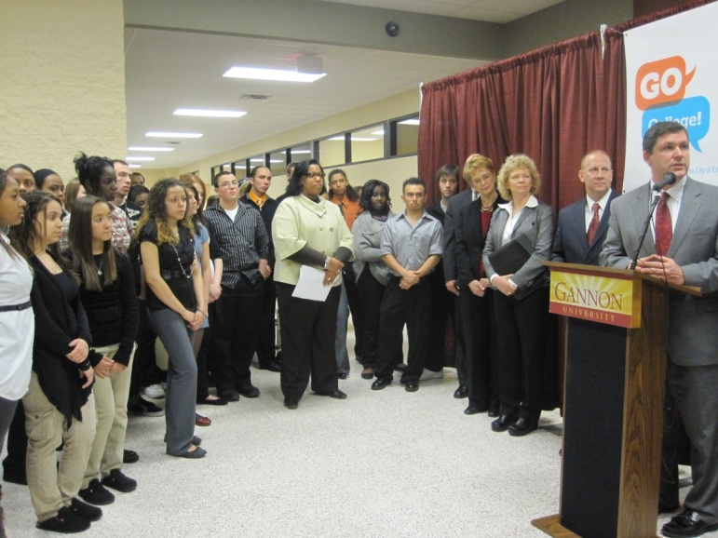
GO College: Collaboration
Engaging the Community
Community events
Churches, community leaders, businesses, parents
Marketing materials
Four press events per year
Press Conference and Launch GO College - Erie
Notes:
GO College – Erie Launch and Press Conference
Engaging the community through marketing materials: Parent Brochure, Student Brochure
Engaging the community through events: Presence at local events, GO College events → community centers, churches, festivals

Slide 12
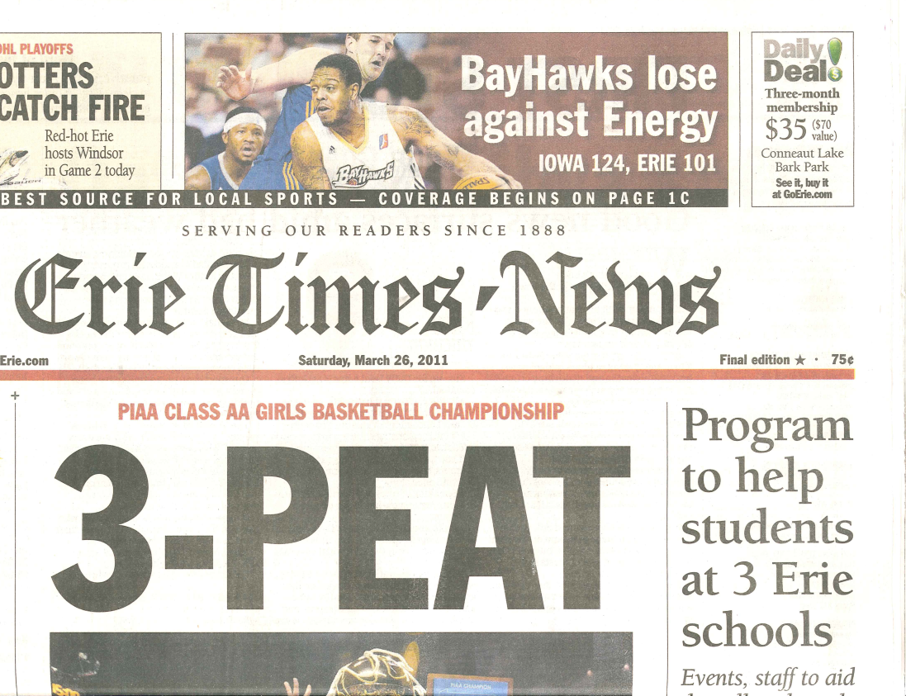

Slide 13
GO College: The Evaluation
A Personal Journey
Contractor Project Director (National Evaluation of Student Support Services, National Evaluation of Talent Search, TRIO performance reporting support contracts)
Department of Education as Technical Monitor
  Did review of evaluation studies from last decade—(not often viewed as useful or valid by practitioners----not often find positive impacts --are we asking the right questions?; how can we make studies more useful and still provide input into policy decisions )
  Has evaluation research –overpromised in terms of validity of results and in terms of usefulness---what does lack of effects mean???)
  Came to see need for taking a more participatory approach involved and began Designing Next Generation of GEAR UP studies that were developed by grantees using technical assistance from RTI –use traditional models of evaluation

Slide 14
GO College: Internal or External Evaluation?
External evaluation required—for I-3 Validation studies using traditional methods meeting What Works Clearinghouse criteria as much as possible—model of validate and then scale up if find positive effects
“The dilemma of whether to use external or internal evaluation is as false as that between qualitative and quantitative methods. The solution is always to use the best of both, not just one or the other” (Michael Scriven)
COE-I3—Go-College Collaborative grant is using both approaches— working collaboratively with ETS and their sub-contractor Brown—ABT is technical assistance provider—(for example, Brown just completed random assignment of rising 9th graders in the 6 schools based on data COE compiled and processed)

Slide 15
Traditional vs. Empowerment Evaluation
Traditional Evaluation
External
Expert
Dependency
Independent judgment
Developed when data not available to all— elite with resources to collect and skill to analyze
Empowerment Evaluation
Internal
Coach or Critical friend
Self-determination & capacity building
Collaboration
Makes use of Data Revolution—internet, web, real time interactive sharing of knowledge—all publish—face book, blog, twitter

Slide 16
Internal and External Evaluation Enhance Each Other
Can provide richer data set that enables more complete external examination
External reality check and quality control—keep on track
External—help question shared bias
Coordinate data needs
Mixed methods
Evaluators—co-equals—not superior or servant

Slide 18
GO College: Null-Hypothesis & Methods
Null Hypothesis
Implementation of the GE-Pilot and the I-3 enhancement strategies will not be accompanied by measurable change in college readiness and college going rates over the period of study for the whole schools
Rising 9th graders randomly assigned to participate in the more intensive learning communities will not differ in outcomes observed from those not invited to participate
Diverse students selected at random from ability quartiles will not differ in outcomes observed from students who volunteer for the learning communities
Associated Methods
Observational study of pre and post –and comparison schools outcome trends in schools over 15 year period–Requesting data from 2000—2015—Case History—–use systems concepts—community asset development study
Experimental study for purpose of understanding best way to select students and to give equal chance for scarce treatment. Departure from usual method of TS of selection based on student and teacher interest
Observational study of differences in outcomes observed in GE pilot in which students volunteered or teachers selected—method used for 10 to 12 graders

Slide 19
GO College: Confounders, Challenges and Opportunities
Dynamic Data Driven Focus---implies using the data to improve services on an on-going basis—intervention changes –we are validating a dynamic context driven adaptive reflective process not a static intervention
Community Initiative and Collaborative data use by all stakeholders lends project to involve internal reflection and self evaluation
Fast Changing Context---examples --Severe cutbacks to schools in districts, US presidential challenge to be first in degrees, data use change, no community college in ERIE and recently voted down, 55 000 degrees-Louisville, ACT collaboration
Whole School and Previous Other services received before and during—Talent Search—GE-Pilot—I-3—Others-limits contrasts and meaningful counterfactuals

Slide 20
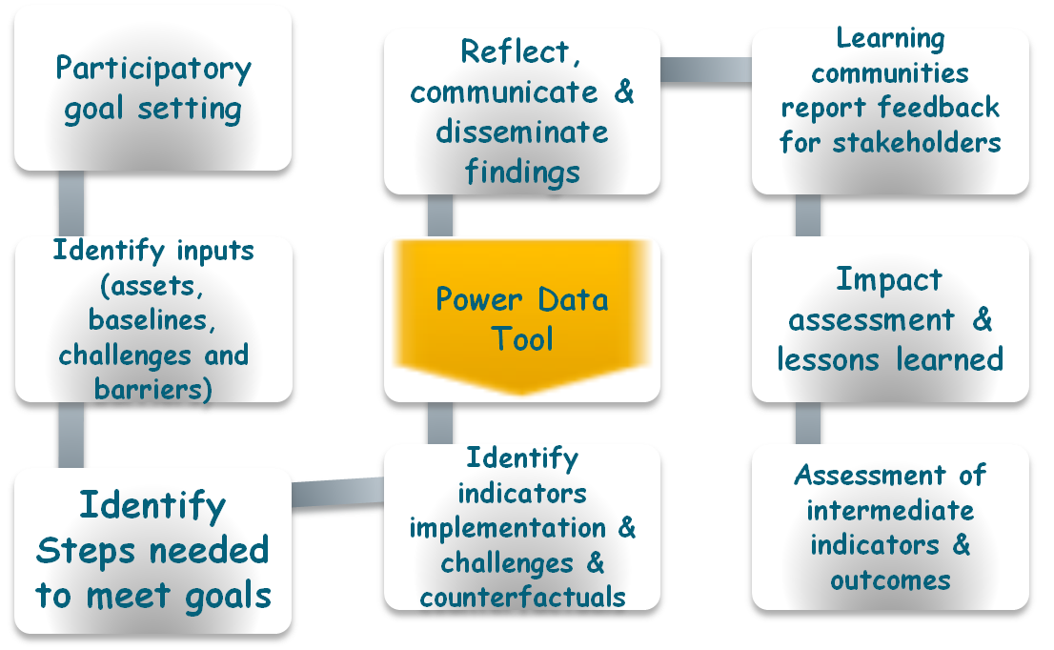
Go-College: Collaborative –Process of Participatory Action & Change

Slide 21
Using Empowerment Evaluation As Internal Evaluation Tool
Empowerment evaluation is the use of evaluation concepts, techniques and findings to foster improvement and self determination. It employs both qualitative and quantitative methodologies.
  Empowerment evaluation: Knowledge and Tools for Self-Assessment and Accountability Fetterman, Kaftaraian, and Wandersman 1996
  Widely-used
      Joint Committee for Education Program Standards have included concepts
      American Evaluation Association and AERA workshops
      Public Health Field
      International Development work
      Education school systems

Slide 22
10 Key Principals of Empowerment Evaluation(Wandersman et. Al 2005)
Community Ownership— primary responsibility with organization and not outside evaluator
Inclusion— involves representation of key stakeholders
Democratic participation— highly collaborative—opportunity to voices questions—every stakeholders voice is heard
Community knowledge- promotes growth of knowledge in community—stakeholders are considered to be in the best position to understand the issues and generate solutions to problems
Evidence Based strategies- promotes use of strategies with high quality evidence—research evidence of effectiveness—evidence strategies contextualized to fit community

Slide 23
10 Key Principals of Empowerment Evaluation(cont.)
Accountability- provides data that can be used to determine whether a strategy has achieved its goals—negative results are used to inform change in a strategy or the selection of a new strategy for the purpose of producing better outcomes
Improvement— Helps organizations improve strategies so that they are more likely to achieve stated goals—process and outcome evaluation (Rossi 1999)
Organizational learning—fosters a culture of learning—view positive and negative feedback as valuable information and believe that all strategies can be improved
Social justice— Increase capacity to reduce disparities that affect marginalized by persecution, discrimination, prejudice and intolerance
Capacity building— builds capacity of organizations to conduct their own evaluations, understand results and use them to continuously improve organization

Slide 24
Preliminary Plan of Topics for Stakeholder Collaborative Report
Ethnographic school histories: Quantitative and qualitative, outcomes assessment
Assessment of the strategies effectiveness and recommendations for improvement (collaboration, data use, whole school, learning communities, diversity/asset based)
Implications for Talent Search and College Access Programming
Modeling Meeting the 2020 College Attainment goals—student contributions –data use (international, national, state, local, individual)
Reflections on use of innovative empowerment evaluation tool—evaluate the evaluation tool

Slide 25
Questions and Answers

