Slide 1

Priced Out:
How the Wrong Financial-Aid Policies Hurt Low-Income Students
SFARN Conference
June 2, 2011
Jennifer Engle and Mamie Lynch

Slide 2
College costs have increased at four times the rate of inflation
Patrick M. Callan, “Measuring Up 2008” (San Jose, California: National Center for Public Policy and Higher Education, 2008), 8. http://measuringup2008.highereducation.org/print/NCPPHEMUNationalRpt.pdf

Slide 3
Meanwhile, earnings among the lowest income families has declined
The College Board, “Trends in College Pricing 2010” (New York: College Board, 2010), 24. http://trends.collegeboard.org/downloads/College_Pricing_2010.pdf

Slide 4
It’s not surprising then that families think college affordability is key
Public Agenda, “Slip Sliding Away Survey Results” (New York: Public Agenda, 2011), 3-5. http://www.publicagenda.org/files/pdf/struggling-in-america-topline.pdf

Slide 5
But policies at all levels are shifting funds away from the students who need the most support

Slide 6
Federal Pell Grants have failed to keep pace with rising college costs
Total Cost of Attendance Covered by
Maximum Pell Grant Award
Source: American Council on Education (2007). “ Status Report on the Pell Grant Program, 2007” and CRS, Federal Pell Grant Program of the Higher Education Act: Background, Recent Changes, and Current Legislative Issues, 2011.

Slide 7
In the same year, $19.4 billion was spent on college tax breaks that primarily benefit middle and upper-income families
 | 2010 Expenditures
Lifetime Learning Credit | $3.5 billion
American Opportunity Tax Credit | $15.1 billion
Deduction for higher education expenses | $0.8 billion
Total | $19.4 billion
Office of Management and Budget, Supplemental Materials, Tax Expenditures Spreadsheet, Table 17-1. Estimates of Total Income Tax Expenditures for Fiscal Years 2010-2016. http://www.whitehouse.gov/omb/budget/Supplemental

Slide 8
61% of savings from tuition tax credits go to middle- and upper-income families
Source: Trends in Student Aid 2010, The College Board

Slide 9
91% of savings from tuition tax deductions go to middle- and upper-income families
Note: Percentages may not add to 100% because of rounding.
Source: Trends in Student Aid 2010, The College Board

Slide 10
At the same time, states also have shifted costs onto students and diverted grant funds away from low-income students
Source: Trends in Student Aid 2010, The College Board

Slide 11
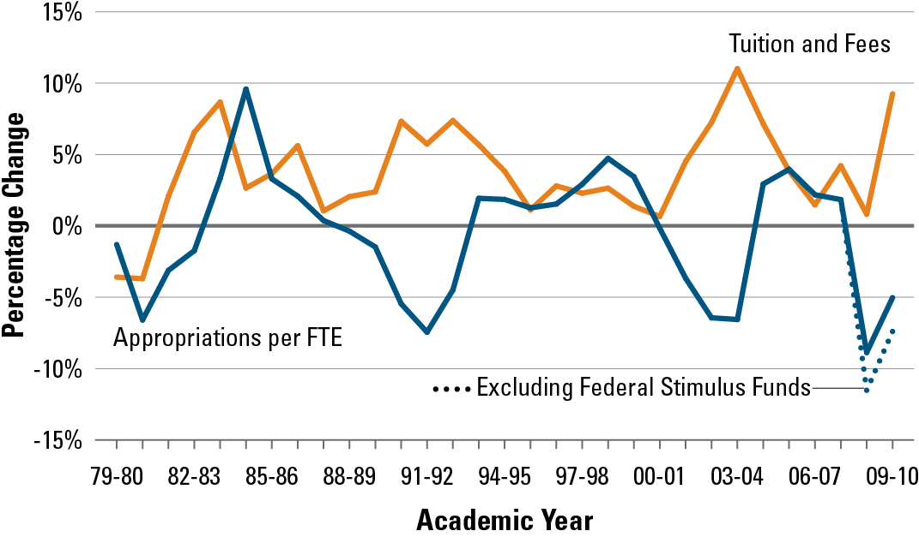
State funding cuts for higher education
mean families pay higher tuition
Annual Percentage Changes in State Tax Appropriations for Higher Education
Per FTE Student and in Tuition and Fees at Public Four-Year Institutions,
Constant 2009 Dollars
Source: College Board (2010). Trends in College Pricing.

Slide 12
Change in Distribution of State Grants Based on Need
Source: NASSGAP Report 2008-09: Undergraduate Grant Aid in Constant 2008-09 Dollars:
1998-99 through 2008-09 (in millions of dollars).

Slide 13
Colleges and universities also
make inequitable choices
with their grant funds
Source: The Education Trust, Priced Out: How the Wrong Financial-Aid Policies Hurt Low-Income Students, 2011

Slide 14
In 2007, four-year public and
private nonprofit colleges
spent nearly $15 billion on grant aid.
Source: Education Trust analysis of NPSAS:08 using PowerStats, http://nces.ed.gov/datalab/. Results based on full-time, full-year, one-institution dependent undergraduates

Slide 15
But, they spent a lot of aid on students who likely would have gone to college without it
Public colleges and universities spent about the same amount of grant funds on high-income students as on low-income students
Private institutions spent nearly twice as much on high-income students as they did on the lowest income students
Source: Education Trust analysis of NPSAS:08 using PowerStats, http://nces.ed.gov/datalab/. Results based on full-time, full-year, one-institution dependent undergraduates

Slide 16
Low-income students must devote an amount equivalent to 72% of their family income towards college costs
Family Income | Average Income | Cost of Attendance | Expected Family Contribution (EFC) | Average Grant Aid | Unmet Need After EFC and Grant Aid | % of Income Required to Pay for College After Grant Aid
$0-30,200 | $17,011 | $22,007 | $951 | $9,704 | $11,352 | 72%
$30,201-54,000 | $42,661 | $23,229 | $4,043 | $7,694 | $11,493 | 36%
$54,001-80,400 | $67,844 | $23,640 | $10,224 | $5,352 | $8,064 | 27%
$80,401-115,400 | $97,594 | $25,050 | $18,158 | $4,554 | $2,339 | 21%
$115,401+ | $173,474 | $27,689 | $37,821 | $3,822 | $-13,953 | 14%
Education Trust analysis of NPSAS:08 using PowerStats, http://nces.ed.gov/datalab/. Results based on full-time, full-year, one-institution dependent undergraduates

Slide 17
How much should low-income students be expected to contribute towards financing their education?

Slide 18
At least no more proportionally as middle-income students contribute:
Middle-income students finance an amount equivalent to 27% of family income
Average income for low-income families is $17,011
$17,011 x 0.27 = $4,600
Source: Education Trust analysis of NPSAS:08 using PowerStats, http://nces.ed.gov/datalab/. Results based on full-time, full-year, one-institution dependent undergraduates

Slide 19
For the first time, we have information on how much low-income students pay at individual colleges and universities.
Net Price = Cost of Attendance — Grant Aid

Slide 20
Two types of net price data
Average net price for all first-time, full-time undergraduates who received any grant or scholarship aid (2006-07, 2007-08, 2008-09)
Average net price by income level for first-time full-time undergraduates who received Title IV financial aid
Source: IPEDS 2009

Slide 21
Net price data limitations
First-time, full-time students only
Overall net price and net price by income not comparable: Different groups of students
Data by income only reliable for low-income students
Data based on in-state tuition, not out-of-state
Does not subtract out private grants
Based on enrolled students – some low-income students may not enroll because of cost
Source: The Education Trust, Priced Out: How the Wrong Financial-Aid Policies Hurt Low-Income Students, 2011
Notes:
Mention NP calculators

Slide 22
How many colleges and universities are viable options for low-income students based on conservative criteria for affordability, quality, and access?

Slide 23
Only 65 institutions have a net price below 27% of family income for low-income students
Education Trust analysis of Net Price data for $0-30,000 income range, IPEDS 2009.
Notes: Ranges are inclusive on the upper end. High-income families spend and amount equivalent to 15% of family income; middle-income families spend an amount equivalent to 27%; low-income families spend an amount equivalent to 72%.

Slide 24
Only 29 low net-price institutions have a graduation rate of at least 50%
Education Trust analysis of Net Price data for $0-30,000 income range, IPEDS 2009.
Notes: Distribution is based on 65 institutions in the net-price sample with a net price for low-income students of $4,600 or less.Ranges are inclusive on the upper end.

Slide 25
Only FIVE low net-price institutions have a graduation rate of at least 50% and at least 30% Pell enrollment
Education Trust analysis of Net Price data for $0-30,000 income range, IPEDS 2009.
Notes: Distribution is based on 29 institutions in the net-price sample with a net price for low-income students of $4,600 or less and a graduation rate of at least 50%.Ranges are inclusive on the upper end.

Slide 26
Given these limited options, what does the landscape of opportunity look like for low-income students?

Slide 28
What are the five institutions that meet relatively conservative criteria for affordability, quality, and access?

Slide 29
Low net-price institutions with a graduation rate of at least 50% and at least 30% Pell enrollment
Institution | State | Net Price for Low-Income ($0-30,000) Students | Grad Rate | % Pell (Full-time freshmen)
University of North Carolina - Greensboro | NC | $1,470 | 51.6 | 31
CUNY Queens College | NY | $1,708 | 51.8 | 39
California State University – Fullerton | CA | $2,412 | 51.6 | 30
CUN Bernard M. Baruch College | NY | $3,220 | 60.3 | 44
California State University – Long Beach | CA | $4,239 | 54.4 | 36
Education Trust analysis of IPEDS 2009.

Slide 30
5

Slide 31
One unique college – Berea College – charges no tuition
“We’re literally the only school in American that says if you can afford to come, you can’t”
-Larry Shinn,
President, Berea College

Slide 32
Berea College is committed to serving low-income students
Unique pricing structure excluded Berea from net price analysis
Average family income of students = $29,291
Labor program: 10-12 hours/wk of work for school
From 2002 to 2009, grad rate increased from 50% to 65%
Since 1997, African American enrollment has grown from 8% to 17%
Strong academic support services and transition programs
The Education Trust, Priced Out: How the Wrong Financial-Aid Policies Hurt Low-Income Students, 2011

Slide 33
Where are the for-profit college companies?

Slide 35
Where are the top-ranked private nonprofit institutions, many of which have large endowments?

Slide 37
Where are the public flagships, which were founded on the principle of broad access to high-quality education?

Slide 39
Only five flagships offer low-income students a net price below $4,600

Slide 40
But they open their doors to far too few low-income students
Institution | State | Net Price for Low-Income ($0-30,000) Students | Grad Rate | % Pell (Full-time freshmen)
University of North Carolina at Chapel Hill | NC | $2,366 | 84.9 | 13
Louisiana State University | LA | $3,079 | 58.9 | 15
University of Florida | FL | $3,188 | 82.5 | 22
Indiana University – Bloomington | IN | $3,383 | 73.6 | 14
University of Virginia | VA | $3,904 | 93.0 | 8
Education Trust analysis of IPEDS 2009.
Note: University of Virginia's and Indiana University-Bloomington's 2008-09 net-price data in IPEDS are erroneous. The data presented here reflect corrected net-price data e-mailed to Ed Trust from UVA and Indiana University.

Slide 41
Public flagships served
7,000 fewer low-income students
in 2007 than in 2004.

Slide 42
Some flagships not only serve small proportions of low-income students, but also do not keep costs low.

Slide 43
The 5 most expensive flagships for low-income students expect them to pay more than $11,000
Institution | State | Net Price for Low-Income ($0-30,000) Students | Grad Rate | % Pell (Full-time freshmen)
University of Washington | WA | $11,661 | 80.7 | 18
Pennsylvania State University, Main Campus | PA | $14,460 | 84.6 | 12
Rutgers University, New Brunswick | NJ | $14,572 | 76.8 | 25
University of Alabama | AL | $15,216 | 65.9 | 14
University of South Carolina, Columbia | SC | $15,578 | 69.1 | 13
Education Trust analysis of IPEDS 2009.
Note: Rutgers University – New Brunswick’s 2008-09 net-price data in IPEDS are erroneous. The data presented here reflect corrected net-price data e-mailed to Ed Trust from Rutgers.

Slide 44
“If we choose to give merit aid to those who don’t need it, we’re wasting our dollars.”
-Larry Shinn,
President, Berea College

Slide 45
Some flagships are so expensive, that a low-income student could more easily afford to go to a selective private college in the state

Slide 46
In 10 states, the top-ranked private is less expensive for low-income students than the public flagship
State | Flagship | Net Price for Low-Income ($0-30,000) Students | Grad Rate | % Pell (Full-time freshmen) | Top-Ranked Private | Net Price for Low-Income ($0-30,000) Students | Grad Rate | % Pell (Full-time freshmen)
MA | UMass, Amherst | $7,072 | 65.7 | 18 | Harvard | $2,170 | 97.9 | 13
CA | UC, Berkeley | $8,170 | 90.2 | 24 | Stanford | $3,120 | 94.9 | 15
TX | U. Texas, Austin | $8,184 | 80.7 | 23 | Rice | $3,008 | 93.4 | 12
NY | SUNY Buffalo | $8,711 | 47.9 | 40 | Columbia | $4,870 | 93.7 | 13
UT | U. of Utah | $10,182 | 57.6 | 14 | Brigham Young | $7,247 | 76.6 | 9
NH | U. New Hampshire | $10,606 | 75.2 | 14 | Dartmouth | $4,007 | 94.2 | 12
TN | U. of Tennessee | $10,724 | 60.6 | 18 | Vanderbilt | $3,099 | 90.7 | 8
PA | Penn State | $14,460 | 84.6 | 12 | U. of Pennsylvania | $6,704 | 95 | 10
NJ | Rutgers U., New Brunswick | $14,572 | 76.8 | 25 | Princeton | $3,110 | 96.7 | 10
AL | U. of Alabama | $15,216 | 65.9 | 14 | Samford U. | $12,825 | 74 | 12
Education Trust analysis of IPEDS 2009.
Note: Rutgers University’s 2008-09 net-price data in IPEDS are erroneous. The data presented here reflect corrected net-price data e-mailed to Ed Trust from UVA and Indiana University.

Slide 47
The result of these federal, state, and institutional policies?

Slide 48
Only 8 percent of low-income young adults attains a bachelor’s degree by age 24
Tom Mortenson, Bachelor’s Degree Attainment by Age 24 by Family Income Quartiles, 1970 to 2009 (Oskaloosa, IA: Postsecondary Education Opportunity, 2010). http://www.postsecondary.org/default.asp http://www.publicagenda.org/files/pdf/struggling-in-america-topline.pdf

Slide 49
http://www.edtrust.org/node/2369

